Slide 1
CS 7172 Parallel and Distributed Computation Distributed Cache
Kun Suo
Computer Science, Kennesaw State University
https://kevinsuo.github.io/

Slide 2
Outline
Cache in distributed system
Redis
Memcached
Data replication
Synchronous replication
Asynchronous replication

Slide 3
Why Cache?
From the perspective of the architecture of a single computer, memory and processor speeds are different. If cache technology is not used, the performance of the processor will be greatly limited.

Slide 4
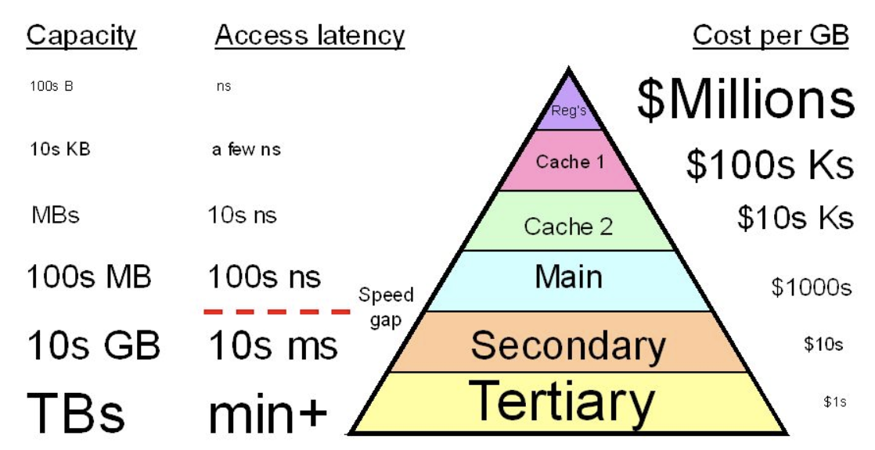
Why Cache?
The application must interact with the database, and the data in the database is stored on the disk. Each request must interact with the disk, and the performance of disk access is very low, which causing significant access delay

Slide 5
Why Cache?
Network access: if there is no caching on the browser, you must interact with the remote machine each time you visit the host, which is very slow

Slide 6
Cache and Distributed Cache
Cache: use a faster storage device to store some frequently used data for quick access by users. Users don't need to interact with slow devices every time, so it can improve access efficiency

Slide 7
Cache and Distributed Cache
Distributed cache: in a distributed environment or system, store some popular data near the user and the application, and store the data on faster devices to reduce the delay of remote data transmission
Data B
Data A
Data A
Data B

Slide 8
Distributed Cache in Redis
Redis: Remote Dictionary Server
Store data in memory with a dictionary structure. Applications can read and write data stored in Redis directly in memory
Decentralized structure, each node is responsible for storing some data

Slide 9
Distributed Cache in Redis
Three features that are most closely related to the cache in Redis:
support for multiple data structures
support for persistence
active-standby synchronization

Slide 10
Support for multiple data structures
Redis is a memory-based key-value database. The supported data structures include not only simple k/v types, but also complex types such as List, Set, and Hash.
Redis treats Hash as an entity and store it as value in the K/V store

Slide 11
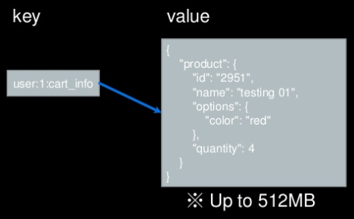
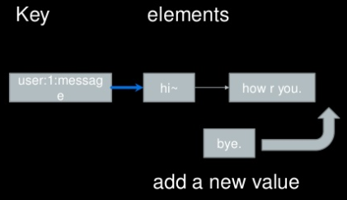
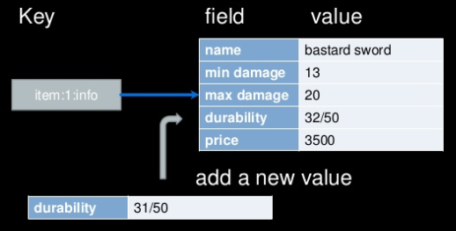
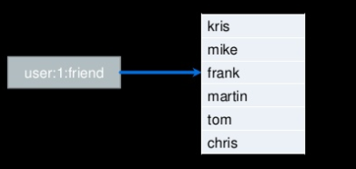
Support for multiple data structures
String
List
Hash
Set

Slide 12
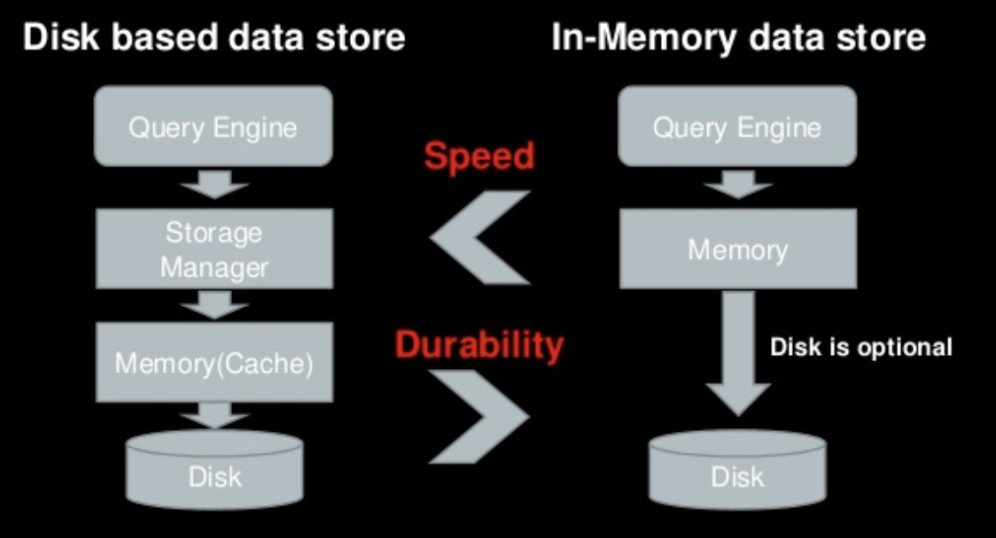
Support for persistence

Slide 13
Support for persistence
Although the data stored in Redis is based on memory, it provides two ways for persistence: RDB and AOF.
RDB (Redis DataBase), also known as the snapshot method: Redis periodically backs up the data in memory to disk to form a snapshot.
AOF (Append Only File): records all update operations in Redis

Slide 14
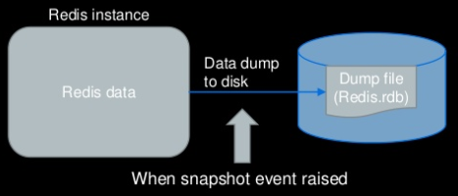
Support for persistence
RDB (Redis DataBase), also known as the snapshot method: Redis periodically backs up the data in memory to disk to form a snapshot.

Slide 15
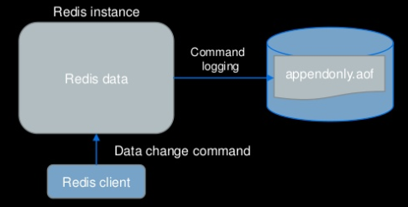
Support for persistence
AOF (Append Only File): records all update operations in Redis

Slide 16
Active-standby synchronization
The complete synchronization:
1. When the standby server starts, it will send a SYNC command to the master server;
2. After receiving the command, the master server will generate an RDB (snapshot) file and record the new write operations performed from now on;
SYNC
Master node
RDB
Standby node

Slide 17
Active-standby synchronization
The complete synchronization:
3. When the RDB is created, it will send it to the standby server, and the standby server will update the data through the RDB file.
4. After the update is complete, the master server sends the write operation of the new records to the standby server. Then, the data is consistent.
SYNC
Master node
RDB
Standby node
New write updates

Slide 18
Active-standby synchronization
The part synchronization:
Master node only sends the updates to the standby servers and the standby servers perform the writes and keep data consistent
PSYNC
Master node
Standby node
Sends the delta updates since last time

Slide 19
Distributed Cache in Memcached
Memcached is a high-performance memory-based key-value cache database
Memcached adopts consistent hashing with virtual nodes

Slide 20
Support for multiple data structures?
Memcached only supports simple k / v data types.
If users want to store complex data types, such as List, Set, and Hash, they need to handle it by themselves to convert it to a string, and then store it.

Slide 21
Support for persistence?
Memcached does not support persistence
All data in Memcached is located inside memory

Slide 22
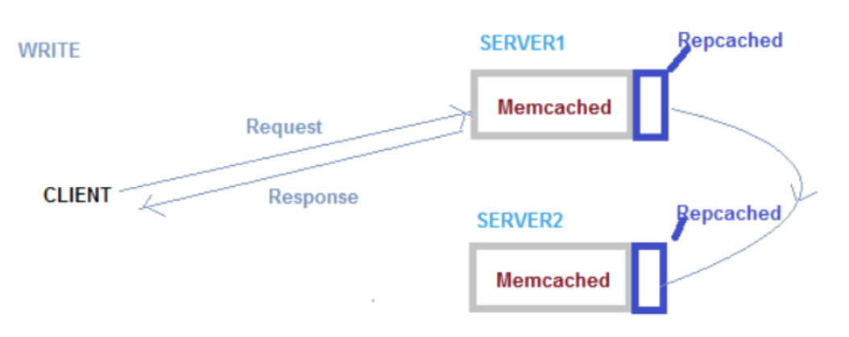
Active-standby synchronization?
In Memcached, there is no communication between the servers
It does not support master/slave by itself. If users want to achieve high availability, they need to implement it through a third party application, such as Repcached

Slide 23
Comparison between Redis and Memcached
 | Redis | Memcached
Storage | Memory + Disk | Memory
Distributed cluster | Redis cluster, each node is responsible for part of hash | Consistent hashing with virtual nodes
Support for data structure | Besides K/V, it supports list, set, hash, etc. | Only K/V
Persistence | Support | Not support
Active-standby synchronization | Complete or part synchronization | Not support, needs 3rd party application

Slide 24
Data replication
Data replication is a way to implement data backup
With data replication, when a node fails, data can be obtained from other nodes that store the data to avoid data loss, thereby improving the reliability of the system.
How to keep the data in the primary and secondary nodes consistent is the main challenges.

Slide 25
Synchronous replication
When a user requests to update data, the primary database must be synchronized to the standby database before it returns to the user. If the primary database is not synchronized to the standby database, the user's update operation will always be blocked.
It guarantees strong data consistency, but sacrifices system availability

Slide 26
Synchronous replication example
Two nodes database: A and B
A is the primary database and B is the standby database
Read: both nodes can receive the user's read request, and then return the data of this node to the user in time
A
B

Slide 27
Synchronous replication example
Write: if the user sends a write request, the write operation must be performed by the master node. Even if the user sends the write request to the standby node, the standby node will forward the request to the master node.
Read and write separation system
E.g., MySQL
A
B

Slide 28
Synchronous replication example
The client sends an update operation V to the primary database and sets X to 2.
The primary database will synchronize the write request to the standby database.
After the standby database operation is completed, the primary database will be notified of the synchronization success.
The primary database will tell the client that the update operation was successful.
Client
4, update succeed
1, update
3, sync succeed
Master
database
Secondary
database
2, data sync

Slide 29
Synchronous replication
Scenario:
It is often used in distributed database with active/standby scenarios or where strict data consistency are required, such as financial and transaction scenarios.

Slide 30
Asynchronous replication
When a user requests to update data, the primary database can directly respond to the user after processing the request, without waiting for the standby database to complete synchronization
The user's update operation will not be blocked even the standby database has not completed data synchronization
This method guarantees the availability of the system but sacrifices the consistency of the data.

Slide 31
Asynchronous replication example
Client 1 sends update operations to master database and set X as 2
The database sends the updated results back directly
The synchronous operation will be performed later
When client 2 read X from standby database before the synchronization, it only gets the old results
Client 1
Client 2
1, update
read
2, update succeed
Master
database
Secondary
database
3, sync later
X=2
X=1

Slide 32
Asynchronous replication
Scenario:
Applications have high latency requirements in response to user requests, e.g., online shopping websites
Example:
Redis cluster

Slide 33
Semi-synchronous replication
After the user sends a write request, the primary database will perform a write operation and send a synchronization request to the standby database, but the primary database can respond to the user without waiting for all the standby databases to respond to the successful data synchronization, which means that the primary database can wait for a portion of the standby database to complete synchronization
Example: Zookeeper cluster

Slide 34
Oracle cluster provides three ways for data replication
Maximum protection mode: for the write request, the primary database is required to complete data synchronization of at least one standby database before it can be successfully returned to the client.
Maximum performance mode: For write requests, as long as the main database is successfully executed, it can be returned to the client.
Maximum availability mode: This mode means that the system adopts the maximum protection mode under normal circumstances, but when there is a network failure between the master and the backup, it switches to the maximum performance mode. After the network is restored, the standby database performs data synchronization.

Slide 35
Comparison
 | Consistency | Availability | Scenario | Example
Synchronous replication | Strong | Weak | Used for strict consistent data scenario such as financial systems | MySQL
Asynchronous replication | weak | Strong | Used for high performance scenarios such as online website | Redis, Oracle
Semi-synchronous replication | Relatively strong | Relatively weak | Used for most of the distributed scenarios | Zookeeper, Oracle, Etcd

